Slide 1
UNCERTAINTY QUANTIFICATION OF AGENT-BASED MODELS WITH APPLICATION TO MALARIA INTERVENTION MODELING
Annual Doctoral Committee Meeting 1
Zenabu Suboi, 26th May 2025

Slide 2
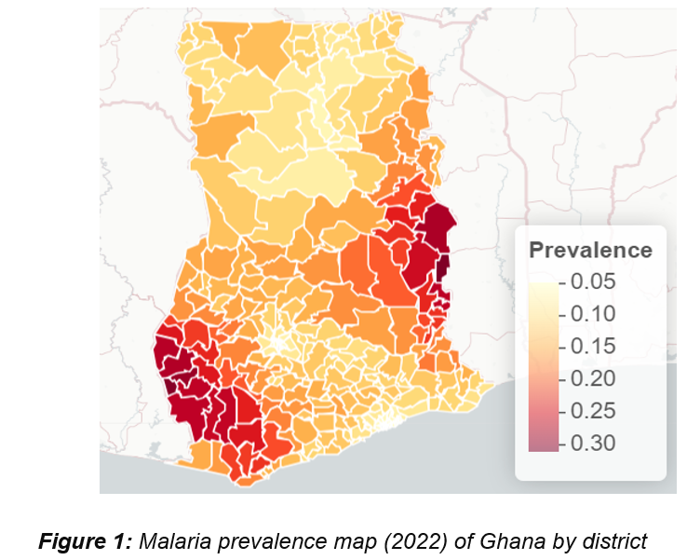
Malaria Prevalence in Ghana is highly heterogeneous
Source: NMEP, figure by: ZS

Slide 3
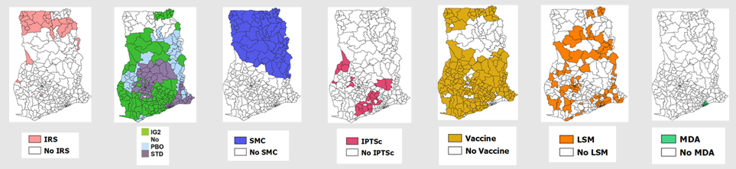
OpenMalaria is used to simulate the impact of interventions for intervention stratification at the sub-national level
Source: MAP, figure by: Sumaiyya Thawer

Slide 4
Uncertainty in Agent-Based Model outputs stem from different sources
Model uncertainty
Stochastic uncertainty
Parameter uncertainty
Observation uncertainty
Model output
Notes:
In the context of ABMs, there are several acknowledged sources from which uncertainty can originate and then propagate through the model.
there are often uncertainties in the real-world process that an ABM is designed to simulate. This can be because any observations taken are inaccurate or because the system is stochastic and, therefore, multiple observations lead to different results

Slide 5
Goal
To quantify and propagate the uncertainty from various parameters in the OpenMalaria Ghana model, beyond just the entomological inoculation rate (EIR) and to determine the impact of these uncertainties on simulating the effect of malaria interventions at the sub-national level.

Slide 6
Uncertainty Quantification can be classified in two forms
The field of Uncertainty Quantification offers a means of quantifying and characterizing uncertainties in models and the real world.
Forward Propagation of Uncertainty
Investigates the impacts of random input values of model parameters on model outputs
Inverse Uncertainty Quantification
using experimental data to learn about the sources of modeling uncertainty
Sensitivity Analysis
Model Calibration

Slide 7
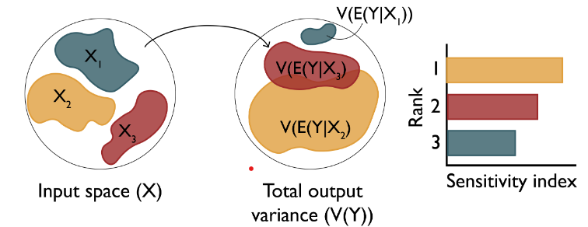
Research Objectives
Objective 1: Understand the key drivers of impact of malaria interventions in Ghana
Objective 3: Simulate the impact of malaria interventions in Ghana in order to support decisions for strategic planning
Objective 2: Develop a novel inference framework for calibrating the OpenMalaria model at a higher spatial resolution
Perform sensitivity analysis of intervention coverage towards incidence reduction and (Forward propagation of uncertainty)
Results of the sensitivity analysis will help the NMEP to carefully choose intervention re-allocation if needed, during the midterm review
The sensitivity analysis will be integrated in the OpenMalaria workflow package, which will be made publicly available
Source: Sensitivity Analysis: The Basics

Slide 8
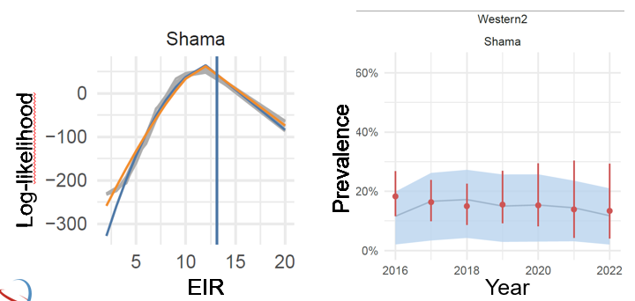
Research Objectives
Objective 1: Understand the key drivers of impact of interventions in Ghana
Objective 3: Simulate the impact of malaria interventions in Ghana in order to support decisions for strategic planning
Objective 2: Develop an efficient inference framework for calibrating the OpenMalaria model at a higher spatial resolution
Develop framework to infer multiple parameters and perform uncertainty quantification for malaria interventions applied to the Ghana data (Inverse uncertainty quantification)
a fully implemented, tested, and documented sampling-based inference framework. This framework will be used to calibrate the OpenMalaria Ghana model
Source: MAP / OpenMalaria simulations
Source: MAP / OpenMalaria simulations
Source: MAP / OpenMalaria simulations
Source: MAP / OpenMalaria simulations

Slide 9
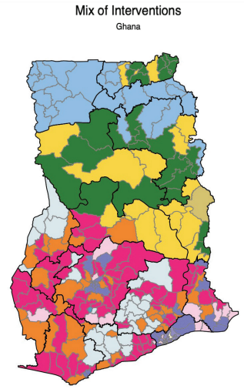
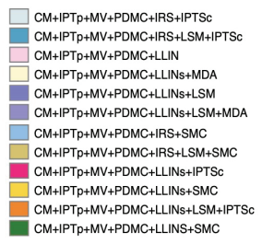
Research Objectives
Objective 1: Understand the key drivers of impact of interventions in Ghana
Objective 3: Simulate the impact of malaria interventions in Ghana in order to support decisions for strategic planning
Objective 2: Develop a novel inference framework for calibrating the OpenMalaria model at a higher spatial resolution
refine modeling scenarios for Ghana at the district level and define prioritization criteria for combinations of interventions
Source: Ghana NMESP 2024-2028.

Slide 10
Progress Update – ACHIEVEMENTS
ACTIVITY | DATE
2024
COURSES (10 ECTS) | FEBRUARY – JUNE
OPENMALARIA TRAINING | MAY – JULY
PROPOSAL WRITING, PRESENTATION AND SUBMISSION | FEBRUARY – AUGUST
MATHEMATICAL MODELING WORKSHOP (CAPE COAST, GHANA) | OCTOBER
2025
COURSES (4 ECTS) | FEBRUARY – JUNE
ASTMH ABSTRACT SUBMISSION | APRIL
MANUSCRIPT | FEBRUARY – ONGOING
OBJECTIVE 1 | SEPTEMBER (2024) – ONGOING
Notes:
To address uncertainties, we identify and quantify the various sources of uncertainty in intervention modeling

Slide 11
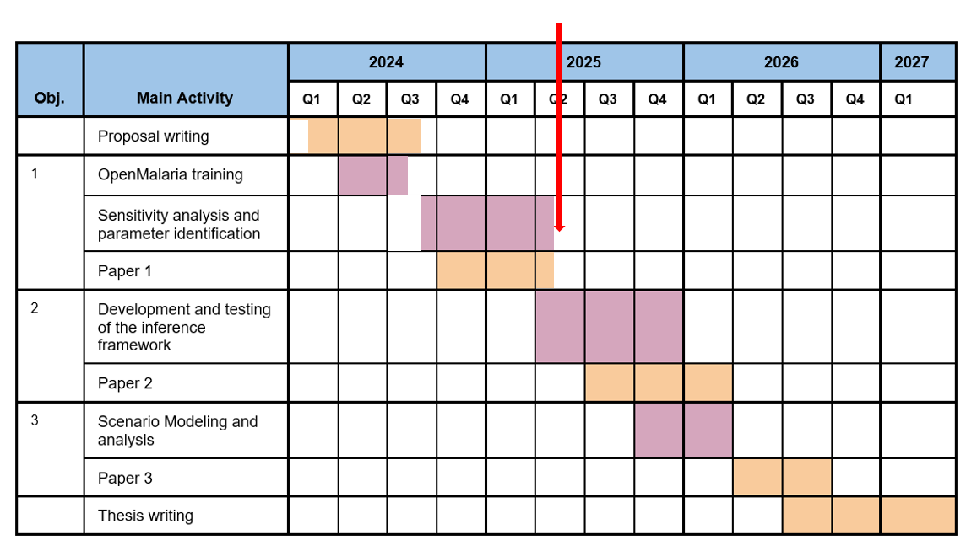
Progress Update – Timeplan (May 2025)
Notes:
To address uncertainties, we identify and quantify the various sources of uncertainty in intervention modeling

Slide 12
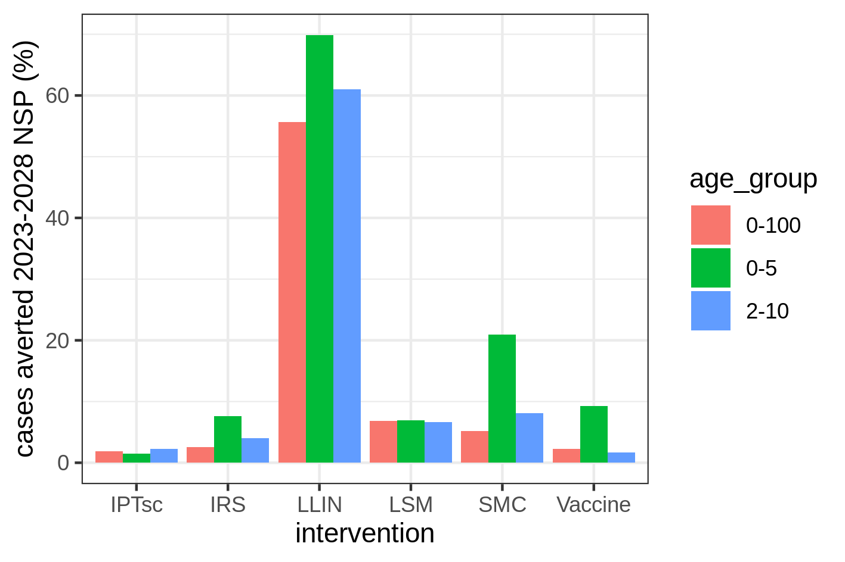
Starting point
Intervention Impact Analysis for the Ghana NMEP – 2023
The updated NSP is comprised of a detailed county-level intervention stratification plan.
To evaluate the impact of each intervention, OpenMalaria was used to model a counterfactual case, where a particular intervention is removed and compared to the full NSP.
The analysis suggested that under-5-year-olds benefit the most from interventions, especially from SMC and vaccine, but also from general vector control measure.
Notes:
LLINs is the most influential in determining the output variance

Slide 13
Global Sensitivity – varied intervention coverage levels to identify drivers of impact within settings and districts
Focus was placed on the four main malaria interventions with high in under-5-year-olds for the sensitivity analysis
Adapted the OpenMalaria workflow to accommodate the varied intervention coverages
Used Sobol’ sensitivity method to obtain first order indices as well as interactions between interventions
Realistic coverage ranges were chosen around the actual coverage levels
LLIN coverage range IRS coverage range SMC coverage range Vaccine coverage range | (0.2,1) (0.4,1) (0.2,1) (0.4,1)
Notes:
LLINs is the most influential in determining the output variance

Slide 14
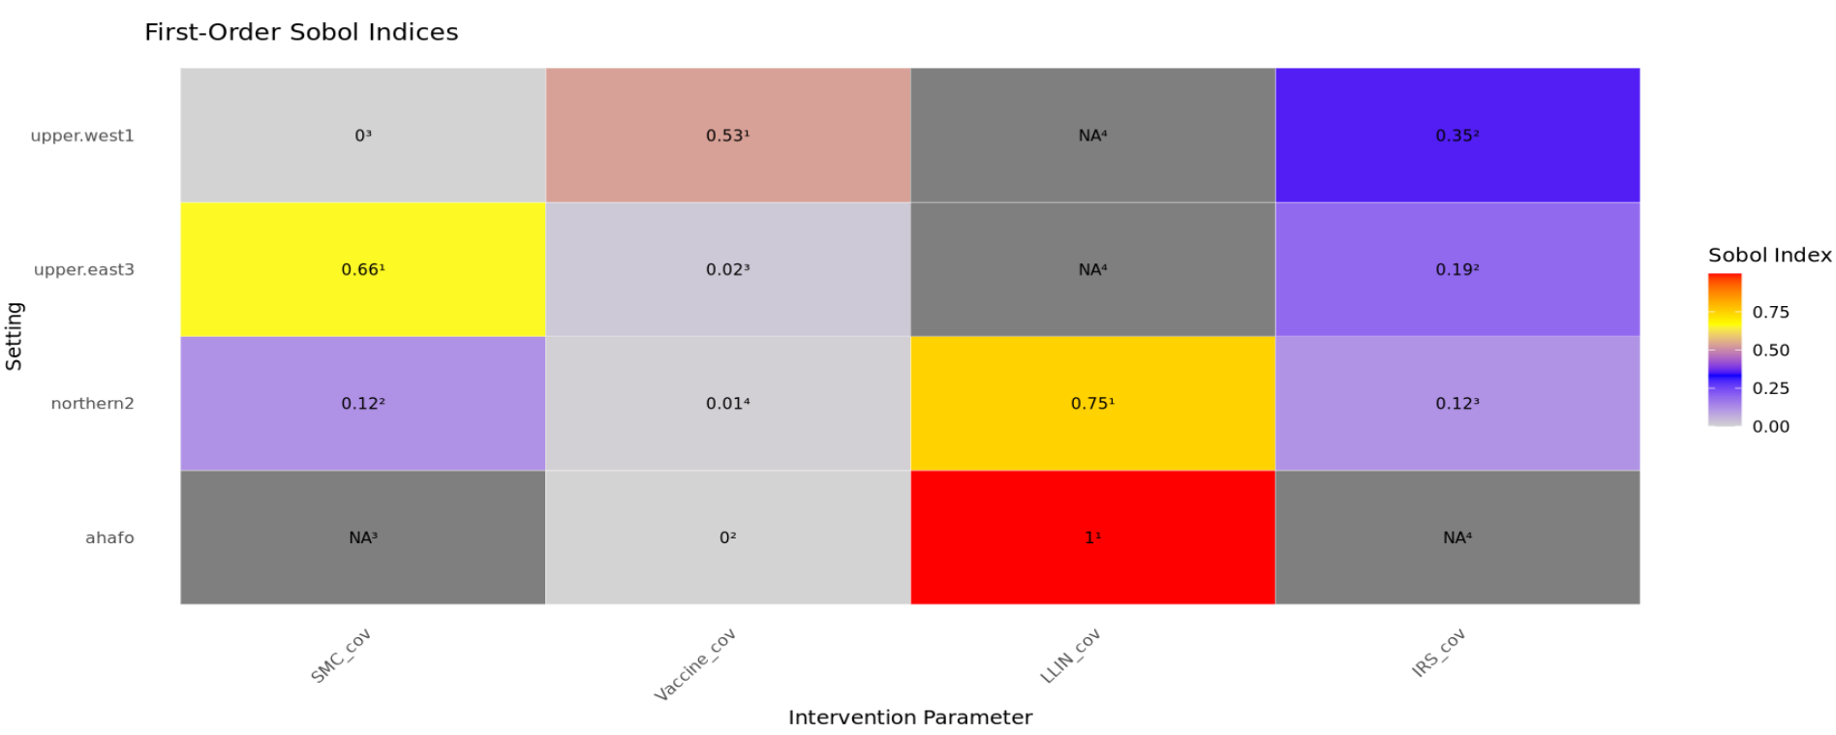
Sobol indices for some selected settings
Notes:
LLINs is the most influential in determining the output variance

Slide 15
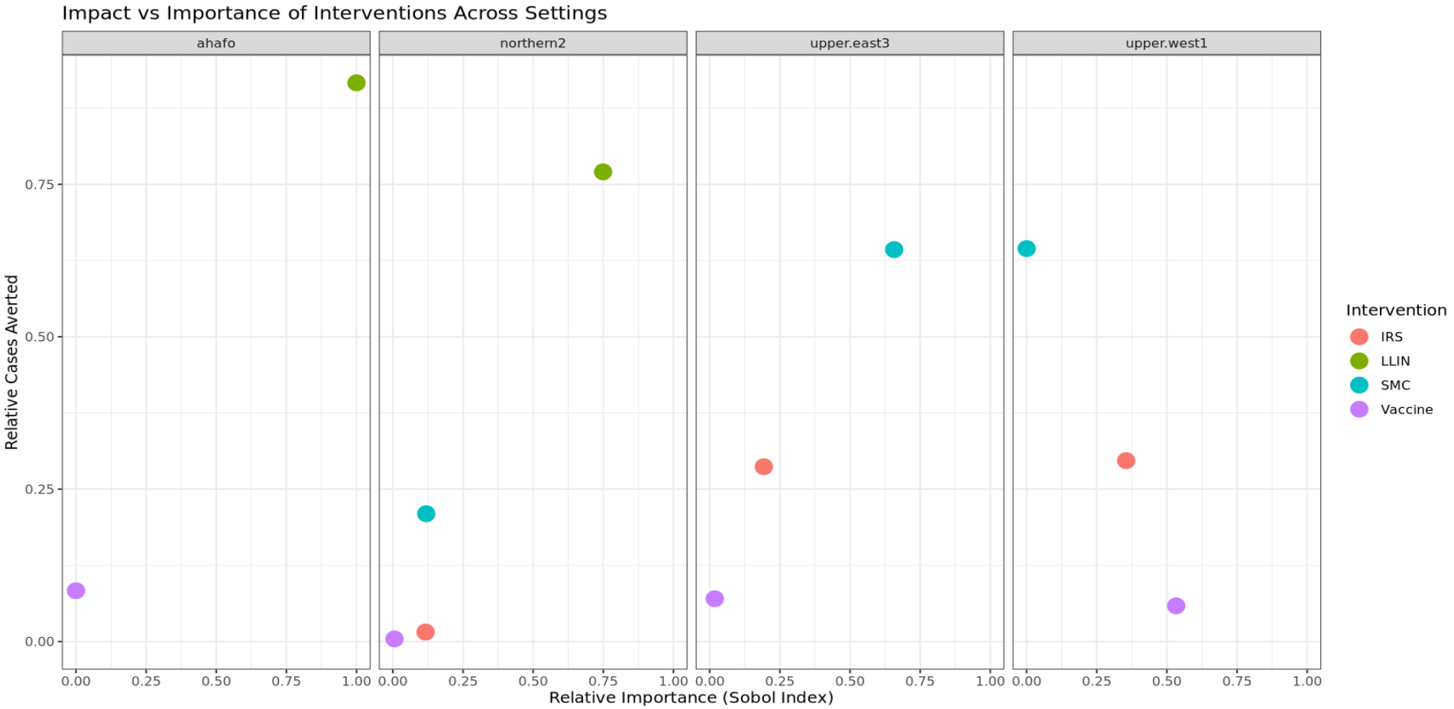
Relative cumulative cases averted vs relative importance per setting
Notes:
LLINs is the most influential in determining the output variance

Slide 16
Moving forward
ACTIVITY | DATE
2025
MATHEMATICAL MODELING WITH AI COURSE / POSTER PRESENTATION | JUNE
COMPLETE MANUSCRIPT FOR OBJECTIVE 1 | JULY
TEACH AT MATHEMATICAL MODELING TRAINING IN KENYA | AUGUST
START WITH OBJECTIVE 2 | SEPTEMBER
Notes:
To address uncertainties, we identify and quantify the various sources of uncertainty in intervention modeling

Slide 17
Thank you for your attention
Notes:
To address uncertainties, we identify and quantify the various sources of uncertainty in intervention modeling

